Slide 1
Docker
System Administration final project
Done by: Arthur Butler and James Faber

Slide 2
What is Docker!
Docker is an open platform for developing, shipping, and running applications.
You may divide your apps from your infrastructure with the help of Docker, allowing for rapid software delivery.
You can manage your infrastructure using Docker in the same manner that you manage your applications.

Slide 3
Purpose of Docker
Docker provides the ability to package and run an application in a loosely isolated environment called a container. The isolation and security allows you to run many containers simultaneously on a given host.
Docker streamlines the development lifecycle by allowing developers to work in standardized environments using local containers which provide your applications and services.

Slide 4
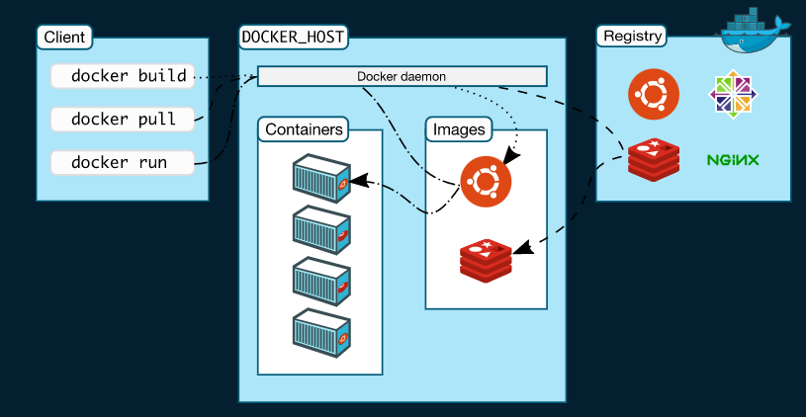
Docker Architecture

Slide 5
Docker Architecture Cont.
The Docker daemon
The Docker daemon (dockerd) listens for Docker API requests and manages Docker objects
The Docker client
The Docker client (docker) is the primary way that many Docker users interact with Docker.
Docker Desktop
Docker Desktop is an easy-to-install application for your Mac, Windows or Linux environment that enables you to build and share containerized applications and microservices.

Slide 6
Docker Architecture Cont.
Docker registries The Docker daemon (dockerd) listens for Docker API requests and manages Docker objects.
Docker objects The Docker client (docker) is the primary way that many Docker users interact with Docker.

Slide 7
Docker Objects
Images An image is a read-only template with instructions for creating a Docker container. Often, an image is based on another image, with some additional customization.
Containers A container is a runnable instance of an image.

Slide 8
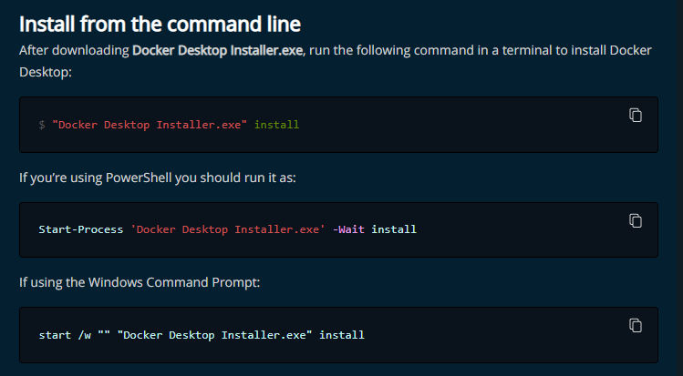
How we installed Docker

Slide 9
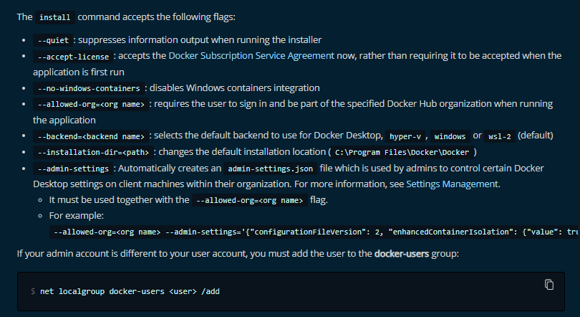
How we installed Docker Cont.

Slide 10
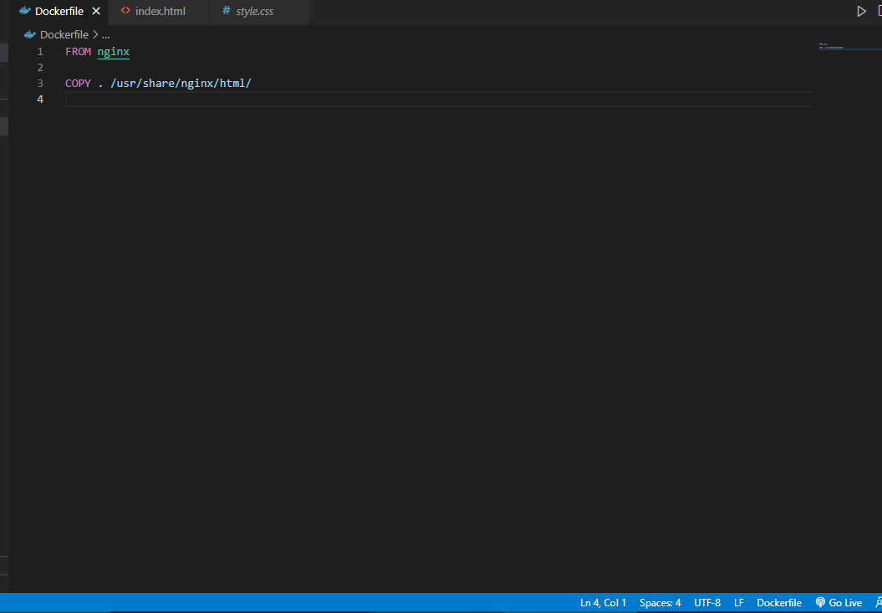
How we created a Docker File

Slide 11
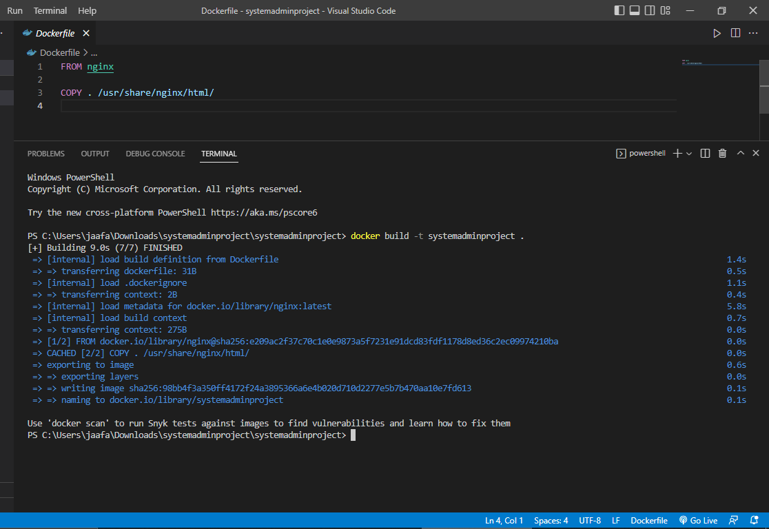
Build and Run
Command: docker build -t systemadminproject .

Slide 12
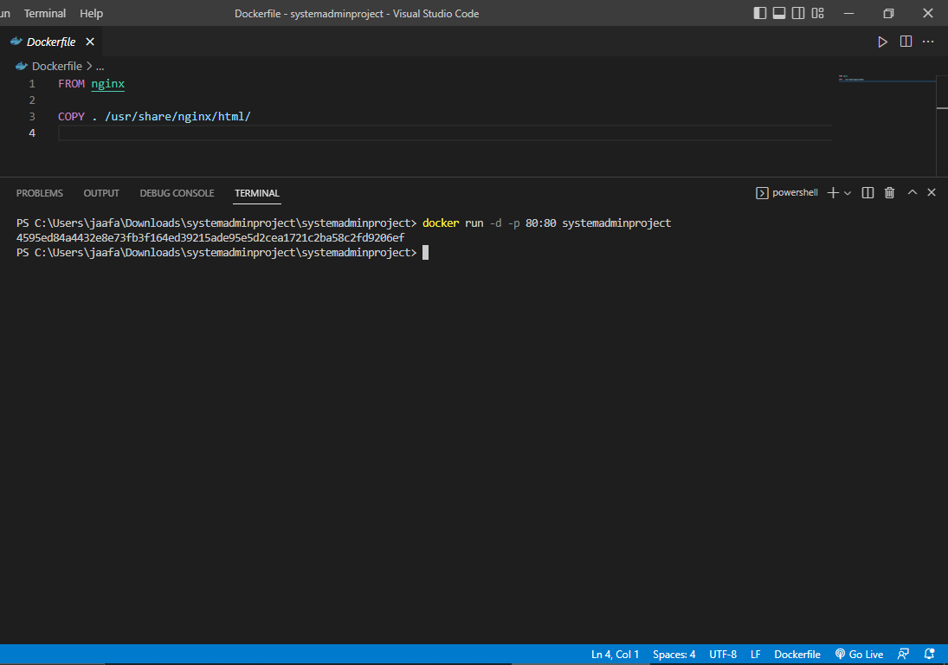
Build and Run Cont.
Command: docker run -d -p 80:80 systemadminproject

Slide 13
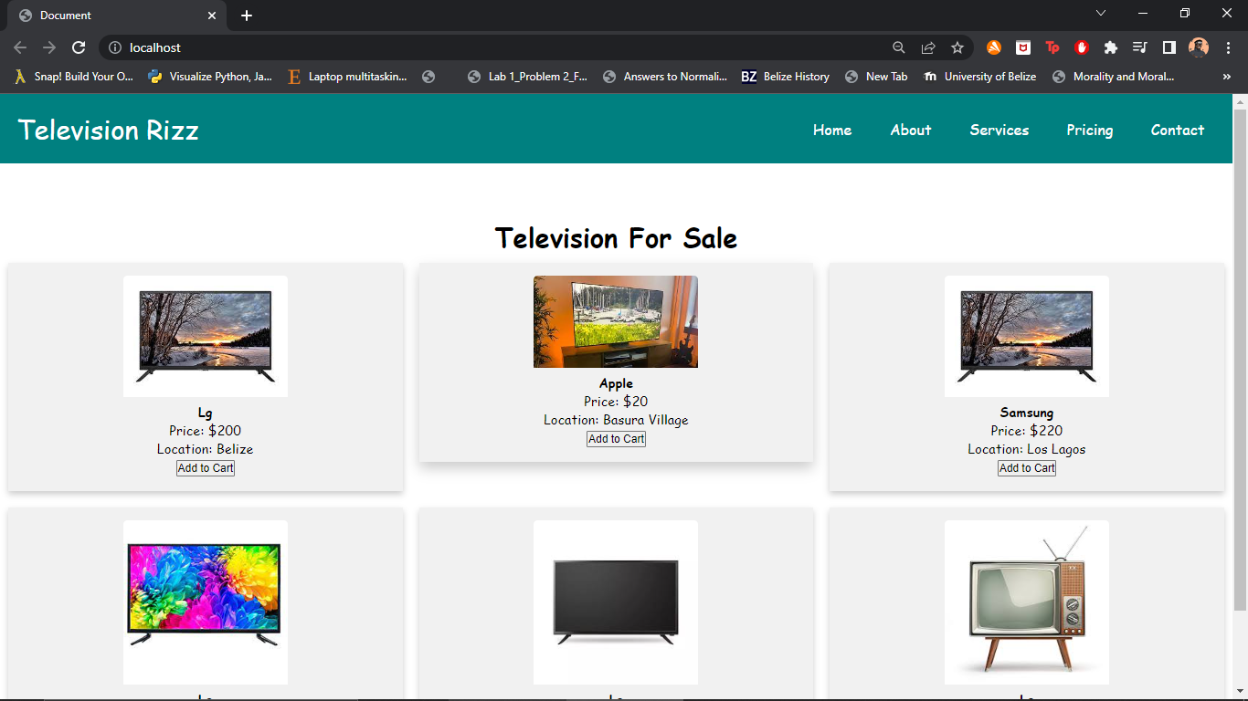
OutPut

